Slide 1

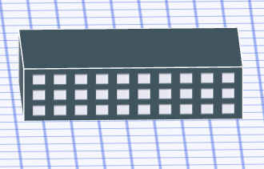
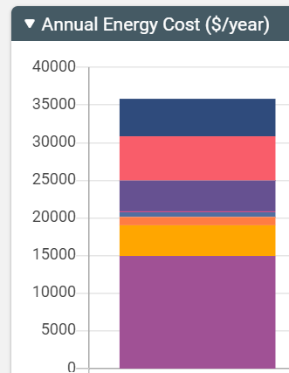
Sketchbox™ by Slipstream
Lesson 4
Carbon Emissions

Slide 2


Slide 3
Carbon emissions due to energy use in buildings
Providing the energy used in buildings, most often from electricity and natural gas, produces emissions
Emissions of carbon dioxide and other gases cause changes to the Earth’s atmosphere
Reducing energy use generally reduces emissions

Slide 4
Carbon emissions due to energy use in buildings
Impact of different types of emissions can be added together into a value called a carbon dioxide equivalents
Different means of producing electricty result in different amounts of emissions for each kilowatt hour of electricity produced

Slide 5
In this lesson you will focus on:
Carbon equivalent emissions from different energy sources
Relationship between energy use and emissions
Variation in emissions for electricity generation by location (City and State)

Slide 6
Lesson Objectives:
Students can explain the meaning of carbon dioxide equivalents
Students can use the Sketchbox™ interface to model the energy use of a building and, using the results, calculate the annual carbon dioxide equivalent emissions
Students can list several factors that affect carbon emissions that result from energy used in buildings

Slide 7
Important terms:
Carbon equivalent or CO₂ equivalent – the total thermal energy absorbing impact that emissions gases add to the atmosphere; gases other than carbon dioxide are added as the amount of carbon dioxide that creates the same effect
Emissions – exhaust gases that are produced when using a fuel to produce electricity or release thermal energy

Slide 8
Common energy measurement units:
kWh – kilowatt hour, a unit of energy often used for electricity; equal to the energy used at a rate of one kilowatt for one hour
Therm – an energy unit often used to measure natural gas; one therm is equivalent to 100,000 British Thermal Units (BTU’s)
kW – kilowatt, a unit of power often used to describe how fast electrical energy is used; one kilowatt is one thousand watts
BTU – British thermal unit, energy unit often used in heating and cooling
kBTU – unit of energy equal to one thousand BTU’s

Slide 9
Measurement units for emissions:
Kg CO₂e / kWh – the amount of carbon dioxide creating the same effect as all the gases released producing each kilowatt hour of electricity
Kg CO₂e / therm - the amount of carbon dioxide creating the same effect as all the gases released when a therm of natural gas is used

Slide 10


This lesson uses the project and baseline tabs

Slide 11
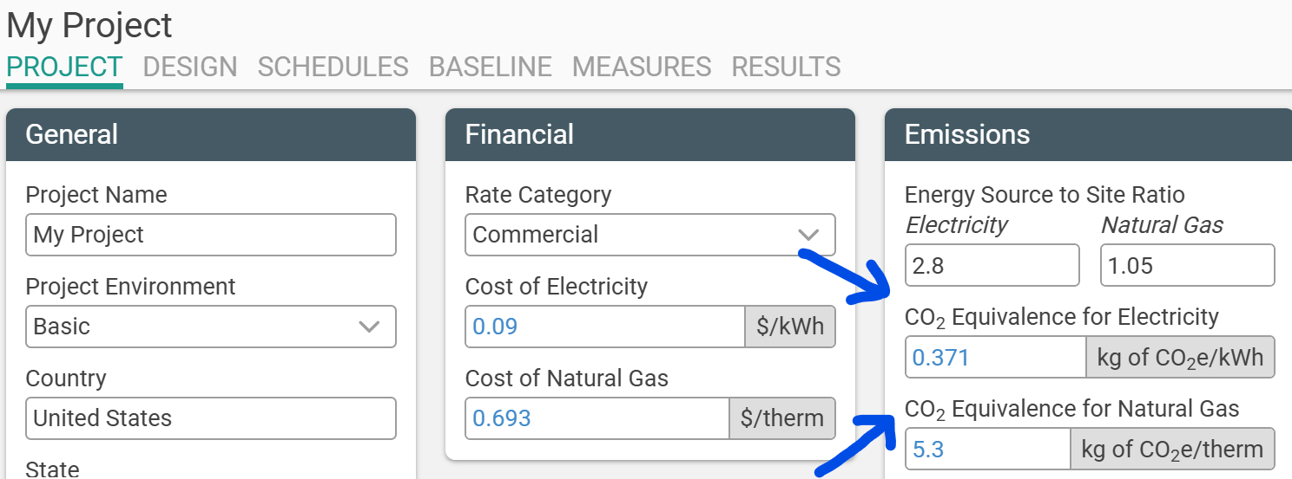
Project tab gives kilograms carbon dioxide equivalent for electricity produced for a building’s location

Slide 12
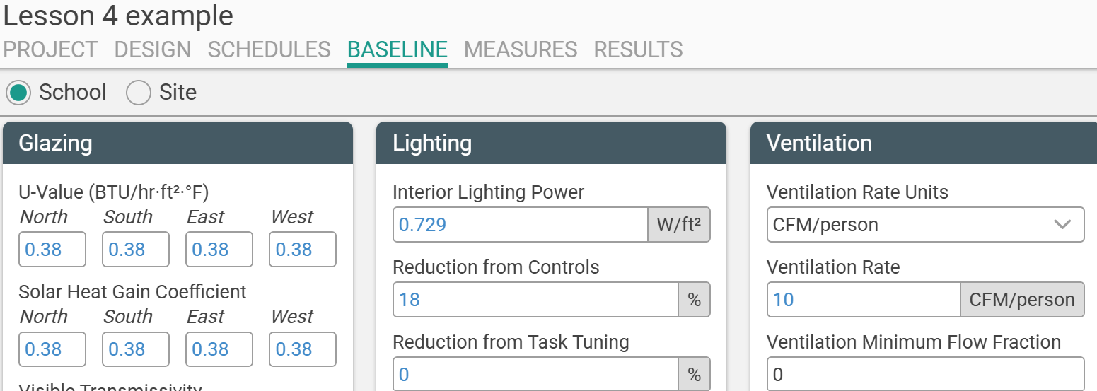
Baseline tab allows easy changes to building characteristics to explore emissions reductions

Slide 13
Lesson 4 Building Model
50,000 square foot medium office building in Chicago
Changes include lower lighting power intensity, demand control ventilation, a location with different electricity generation emissions (Madison, WI)

Slide 14
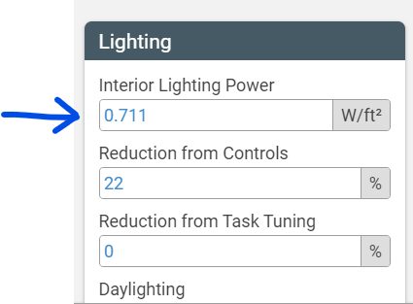
Baseline tab allows easy changes to building characteristics to explore emissions reductions

Slide 15
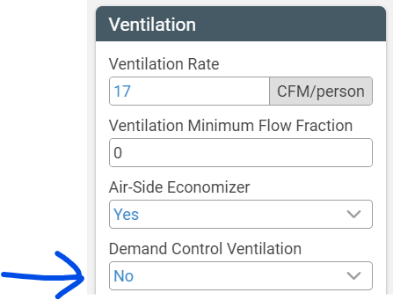
Baseline tab allows easy changes to building characteristics to explore emissions reductions

Slide 16
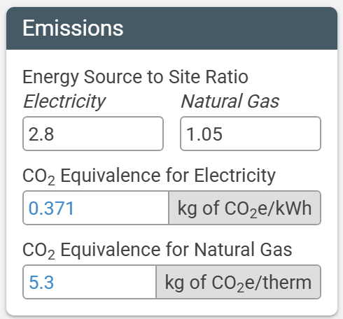
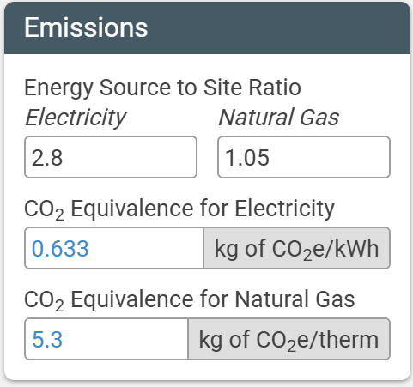
Project tab gives emissions rates for electricity and natural gas for each available location
Illinois Wisconsin

Slide 17


https://slipstreaminc.org/sketchbox
Notes:
https://slipstreaminc.org/sketchbox

Slide 18
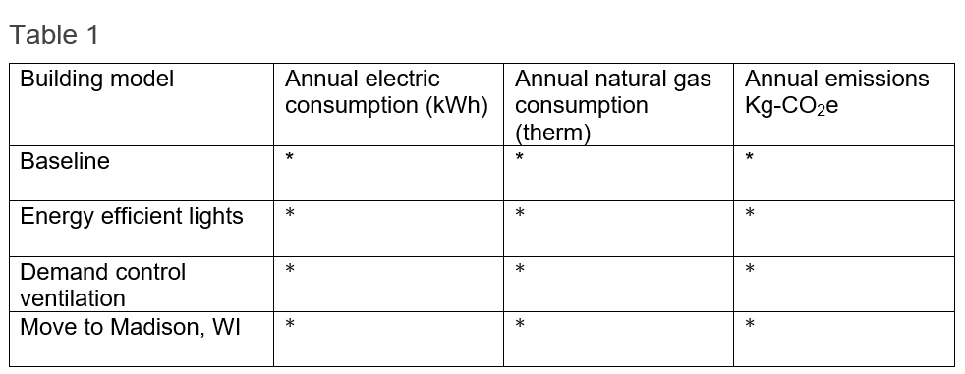
Student Data Table
Notes:
Chat: https://forms.office.com/r/XWvFWevVF0

Slide 19
Lesson 4 – Carbon Emissions: Sample RESULTS
Values will change over time as updates are made
Scenario | Electricity (kWh) | Natural Gas Therms | Kg-CO₂e
Baseline | 325,890 | 7542 | 160,878
Energy efficient lights | 301,831` | 7886 | 153,775
Demand control ventilation | 323,180 | 6234 | 152,940
Move to Madison, WI | 319,475 | 7464 | 241,787

Slide 20
Lesson 4 – Carbon Emissions: Sample Calculation
Kg CO₂e / kWh – 0.371 Kg CO₂e / therm – 5.3
325,890 kWh*0.371 Kg CO2e / kWh + 7542 therm*5.3 Kg CO2e / therm =
120,905 Kg CO2e + 39,973 Kg CO2e = 160,878 Kg CO2e
Scenario | Electricity (kWh) | Natural Gas Therms | Kg-CO₂e
Baseline | 325,890 | 7542 | 160,878

Slide 21
Lesson 4 – Carbon Emissions: discussion questions
Scenario | Electricity (kWh) | Natural Gas Therms | Kg-CO₂e
Baseline | 325,890 | 7542 | 160,878
Energy efficient lights | 301,831` | 7886 | 153,775
Demand control ventilation | 323,180 | 6234 | 152,940
1. Compare the carbon reduction for the two building changes. Which is better? What other factors matter?

Slide 22
Lesson 4 – Carbon Emissions: Discussion questions
Scenario | Electricity (kWh) | Natural Gas Therms | Kg-CO₂e
Baseline | 325,890 | 7542 | 160,878
Move to Madison, WI | 319,475 | 7464 | 241,787
2. Moving the building from Chicago, IL, to Madison, WI, reduced the energy use but increased the carbon equivalent emissions. Why does this happen?

Slide 23
Optional Extensions
Students can consider what they know about both climate and electricity generation to predict a location where the office building has lower carbon emissions then use Sketchbox to test the result
With some guidance, students can electrify the building in Chicago and examine the resulting carbon emissions
Students can explore the impact of adding solar PV to the building (see next slide)
Notes:
Chat: https://forms.office.com/r/XWvFWevVF0

Slide 24
Integrating Solar Energy with Sketchbox
The National Renewable Energy Laboratory maintains a solar photovoltaic (PV) simulation that can estimate the number of kilowatt hours of solar electricity an array will produce in a given location, given basic characteristics of the array
https://pvwatts.nrel.gov/
Notes:
Chat: https://pvwatts.nrel.gov/

Slide 25
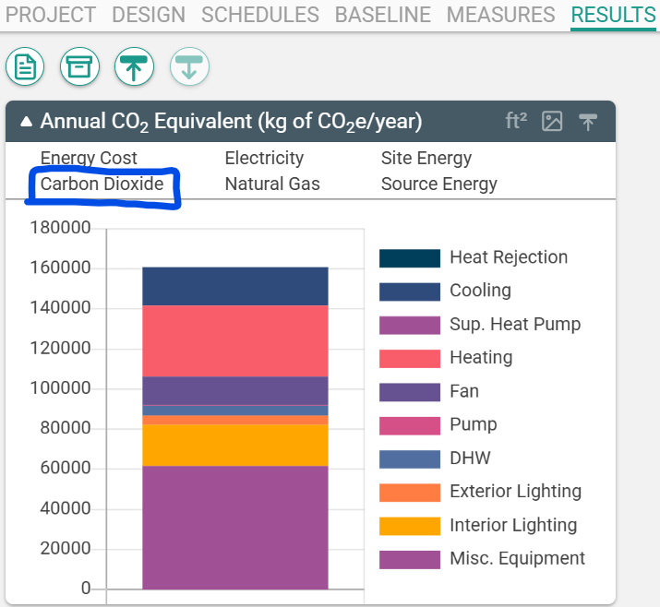
Students can use other displays in the results tab to explore which building energy uses account for the most carbon emissions

Slide 26
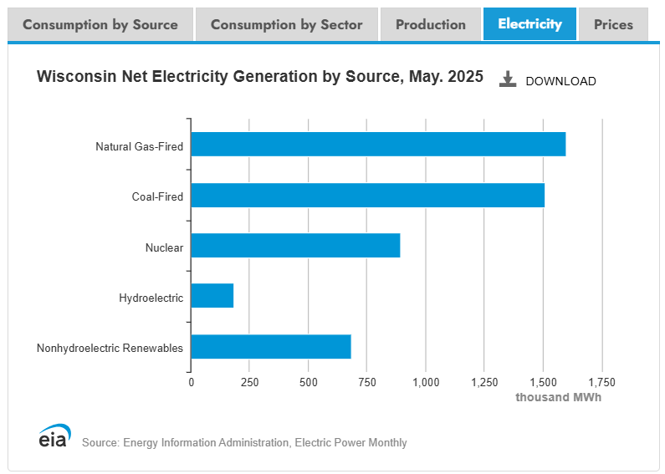
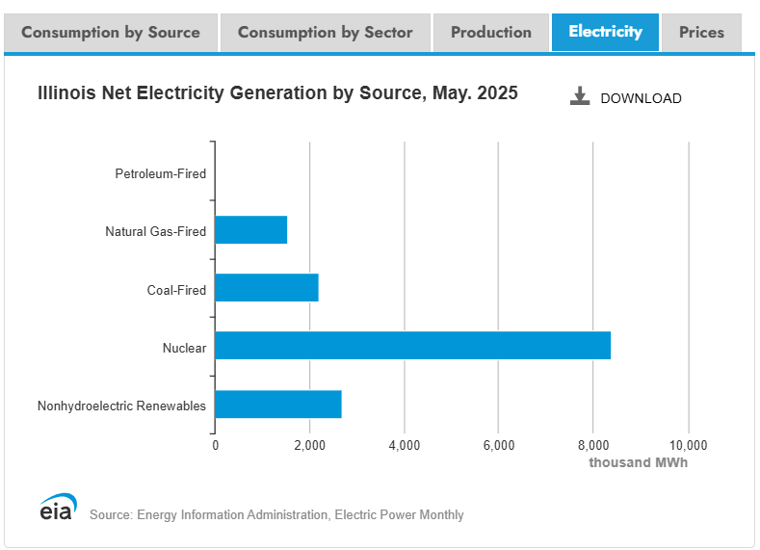
EIA state energy profiles: https://www.eia.gov/state/
Compare electricity generating mixes by state

Slide 27
Related Slipstream Sketchbox™ tutorials
Tutorials for Specific tabs
Sketchbox: Baseline
Or search on the Sketchbox™ youtube channel
Notes:
Chat: https://forms.office.com/r/XWvFWevVF0

Slide 28
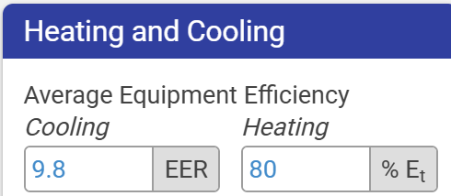
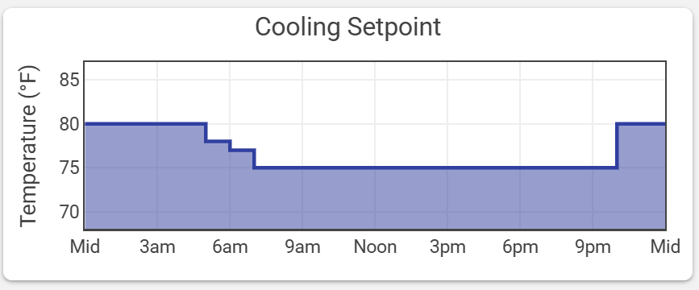
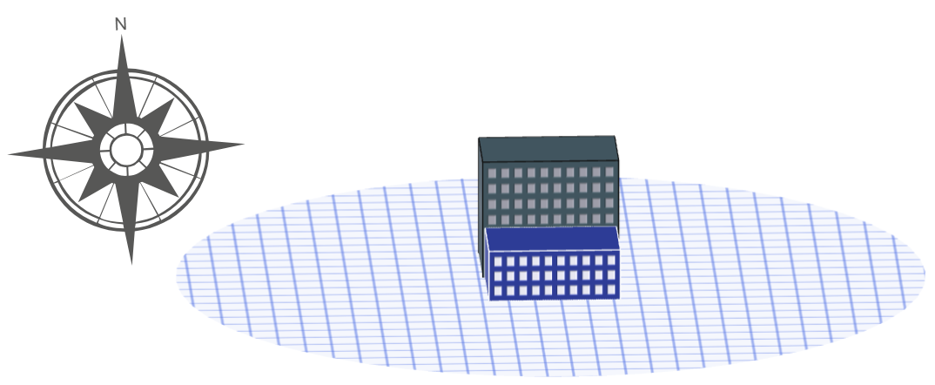
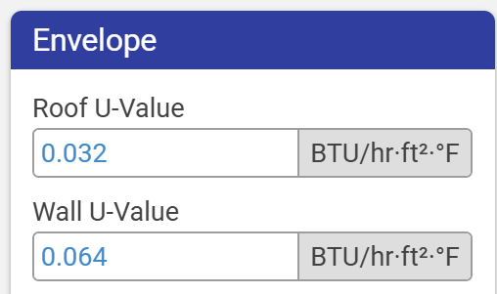
Sketchbox™Lesson 4
End of Presentation- thank you for watching!
Notes:
Chat: https://forms.office.com/r/XWvFWevVF0

