Slide 1

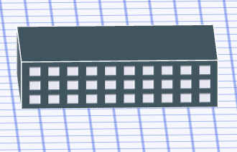
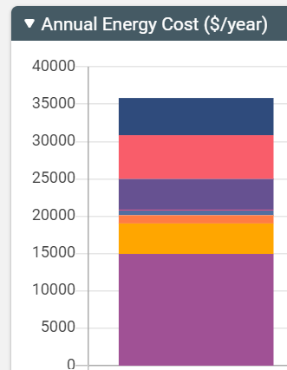
Sketchbox™ by Slipstream
Lesson 3
Schedules

Slide 2


Slide 3
Energy schedules and set points
Buildings use energy to maintain a comfortable indoor temperature and humidity
In general, when the desired conditions for inside a building are further from outdoor conditions more energy is needed
Desired conditions (set points) inside a building may be different at different times of the day, especially when most of a building is not being used; this is done with schedules

Slide 4
In this lesson you will focus on:
Schedules
Set points

Slide 5
Lesson Objectives:
Students can explain what a set point is and why they are often changed at different times
Students can explain different types of building schedules
Students can use Sketchbox™ to examine the impact of changing set points and schedules on building energy use

Slide 6
Important terms:
ASHRAE – American Society of Heating, Refrigeration, and Air Conditioning Engineers
Thermostat – device that activates heating or cooling equipment when building temperatures are too far above or below desired conditions
Temperature Set Point (heating or cooling) –temperature setting for a building; heating or cooling equipment activates when needed to keep the building near the set point

Slide 7
Important terms:
Domestic hot water (DHW) – domestic hot water; water that is heated for sinks, showers, and other uses in the building
Plug load – energy used by a device that plugs into an electrical outlet

Slide 8
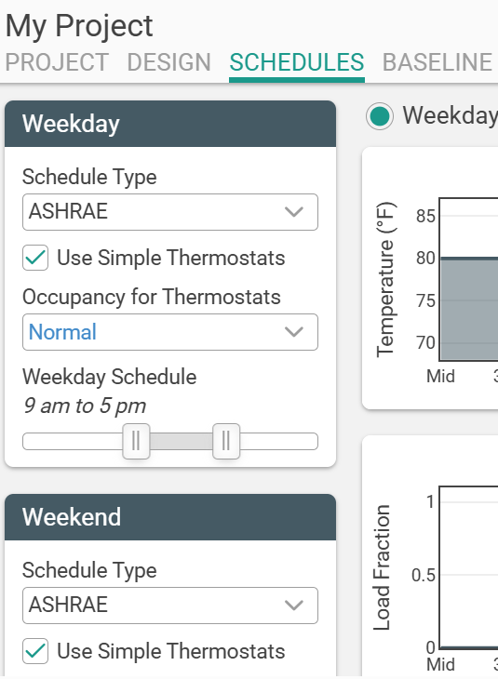
This lesson uses the schedules tab
Notes:
In Wisconsin, Focus on Energy uses the following averages for school buildings
Cost of electricity: $0.1148/kWh
Cost of Natural Gas: $0.996/therm

Slide 9
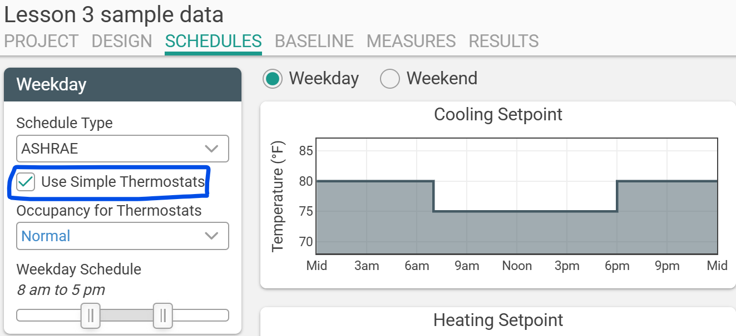
Switch to “simple thermostats” for weekday and weekends

Slide 10
Building Model and Changes
150,000 square foot school building in Chicago, default is building hours from 8am until 5 pm
What if hours are expanded from 8 am until 8 pm or hours are reduced to 8 am to 4 pm?
What if occupied set points are changed from 70 degrees Fahrenheit (heating) and 75 (cooling) to 68 and 77?

Slide 11
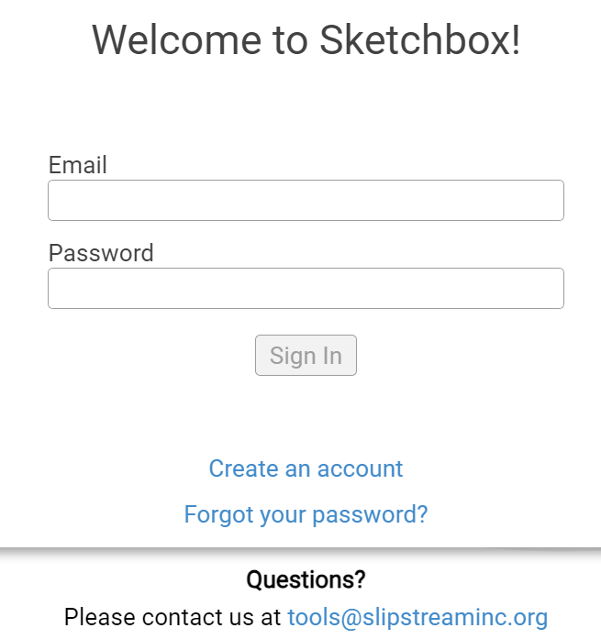

https://slipstreaminc.org/sketchbox
Notes:
https://slipstreaminc.org/sketchbox

Slide 12
Lesson 3 – Schedules - RESULTS
Scenario | Electricity (kWh) | Natural Gas Therms | Total Cost Dollars ($)
Baseline 8am – 5 pm (simple thermostats) | 1,021,040 | 35,304 | 116,360
Weekday 8 am – 8 pm | 1,023,333 | 36,149 | 117,152
Weekday 8 am – 4 pm | 1,019,696 | 34,982 | 116,017
Weekday 8 am – 5 pm new set points | 996,779 | 33,475 | 112,908

Slide 13
Optional Extensions
Compare the simple thermostats baseline to the default ASHRAE schedule (ASHRAE should be more comfortable, at what cost?)
Add occupancy on weekend mornings, how significant is the change?
Notes:
Chat: https://forms.office.com/r/XWvFWevVF0

Slide 14
Lesson 3 – Schedules – Discussion Questions
Scenario | Electricity (kWh) | Natural Gas Therms | Total Cost Dollars ($)
Baseline 8am – 5 pm (simple thermostats) | 1,021,040 | 35,304 | 116,360
Weekday 8 am – 8 pm | 1,023,333 | 36,149 | 117,152
Weekday 8 am – 4 pm | 1,019,696 | 34,982 | 116,017
1. Did changing the building schedule significantly affect energy use or cost?

Slide 15
Lesson 3 – Schedules – Discussion Questions
Scenario | Electricity (kWh) | Natural Gas Therms | Total Cost Dollars ($)
Baseline 8am – 5 pm (simple thermostats) | 1,021,040 | 35,304 | 116,360
Weekday 8 am – 5 pm new set points | 996,779 | 33,475 | 112,908
2. Did changing the temperature set points significantly affect energy use or cost? Are there disadvantages to this change?

Slide 16
Related Slipstream Sketchbox™ tutorials
Tutorials for Specific tabs
Sketchbox: Schedules
Or search on the Sketchbox™ youtube channel
Notes:
Chat: https://forms.office.com/r/XWvFWevVF0

Slide 17
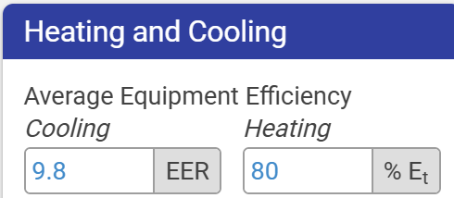
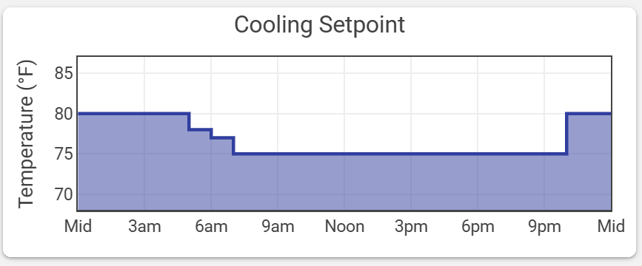
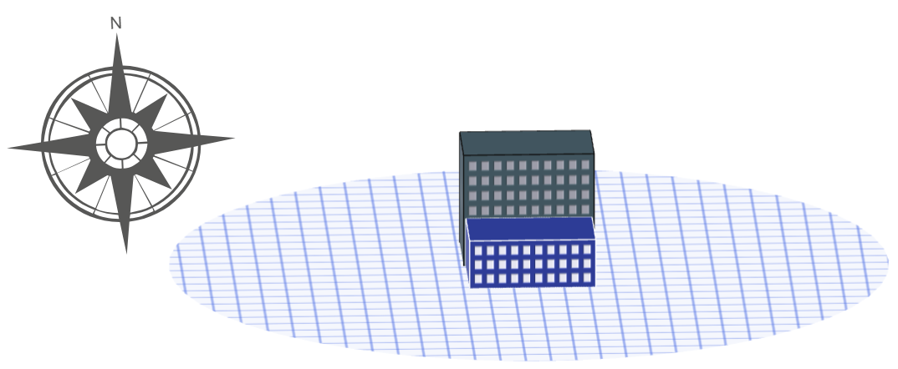
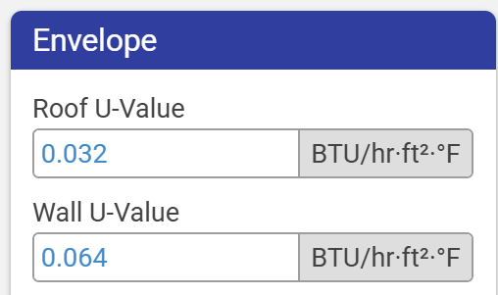
Sketchbox™Lesson 3
End of Presentation- thank you for watching!
Notes:
Chat: https://forms.office.com/r/XWvFWevVF0

