Slide 1


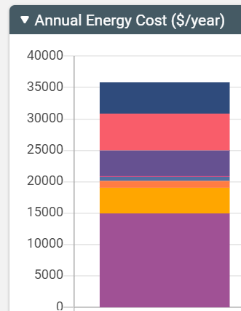
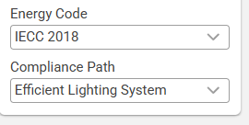
Sketchbox™ by Slipstream
Lesson 2
Energy Codes and Measures

Slide 2


Slide 3
Lesson Objectives
Students can explain what an energy code and how they are used by local governments
Students can use the Sketchbox™ interface to model the energy use of a building built to different energy codes and report the impact of energy code on energy use and cost
Students can use the Sketchbox™ interface to explore different energy efficiency measures and use resulting data to describe relative energy savings from different measures

Slide 4
Energy codes for buildings
Local governments choose to adopt construction codes (legal rules) that apply to electrical, mechanical, safety, and other aspects of buildings
Energy codes specify minimum energy efficiency and design requirements for new and renovated buildings

Slide 5
Energy code organizations
ASHRAE – American Society of Heating, Refrigeration, and Air Conditioning Engineers
ICC – International Code Council creates the International Energy Conservation Code (IECC)

Slide 6
Energy code adoption and update
Local governments choose which code to start using and when it will start to apply
Code organizations update codes every three years, but local governments don’t need to use newest code
Buildings can exceed (be more efficient) than code

Slide 7
In this lesson you will focus on:
Building Energy Codes
Energy Efficiency Measures

Slide 8
Important terms:
Insulation – material that resists the transfer of thermal energy
Air Sealing – closing openings to stop unwanted airflow in/out of a building
U-value – measure of how easily thermal energy transfers through part of a structure such as a roof or wall
SHGC – solar heat gain coefficient, material property that measures how much energy from sunlight (solar radiation) passes through materials like window glass

Slide 9
Important terms:
Interior lighting – lighting inside the building, such as offices and hallways
Exterior lighting – lighting outside building, such as signs and parking lots
Task tuning – adjusting the amount of lighting to what is needed for the activities in a specific space

Slide 10
Important terms:
EER – energy efficiency rating; a number used to rate how effectively cooling equipment uses energy inputs
Demand control ventilation – control strategy that adjusts the amount of fresh air brought into a space based on how many people are inside
Low-flow plumbing fixtures – devices like faucets, shower heads, and toilets designed to use less water than standard models
DHW – domestic hot water; water that is heated for sinks, showers, and other uses in a building

Slide 11
Important measurement unit combinations:
BTU/hr*sq ft*degF British thermal unit per hour square foot degree; BTU’s of energy transfer for each square foot of area, hour of time, and degree Fahrenheit of temperature difference
W/ft² – watts of energy needed for each square foot of building area; often used to measure power needed for lights or equipment
Cfm/ft² – cubic feet per minute of ventilation air for each square foot of building area

Slide 12

Introductory Model
150,000 square foot school building in Chicago
Start with the project tab, note default energy code is IECC 2018

Slide 13
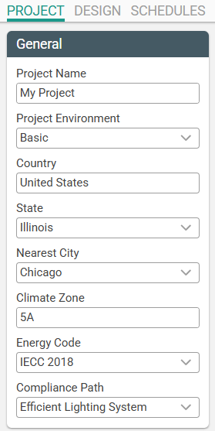
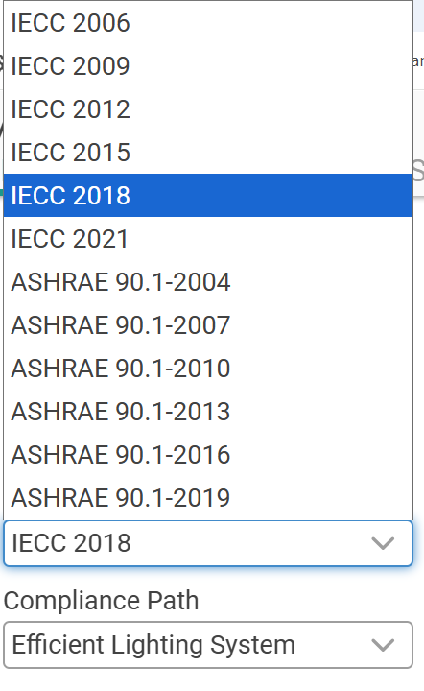
Energy codes
are on the project tab

Slide 14
Sketchbox Example - What if… ?
Energy code is changed to IECC 2015 and then ASHRAE 2016
Upgrades are made to roof insulation, SHGC of windows, lighting efficiency, efficiency of heating equipment
Many improvements are made
Notes:
Chat: https://forms.office.com/r/XWvFWevVF0

Slide 15
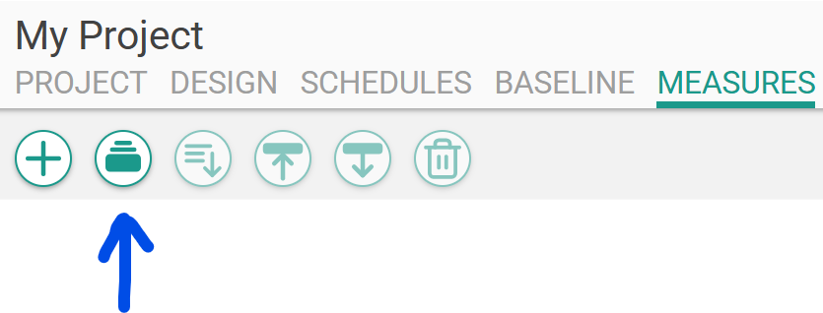
Measures sets added from the measures tab

Slide 16
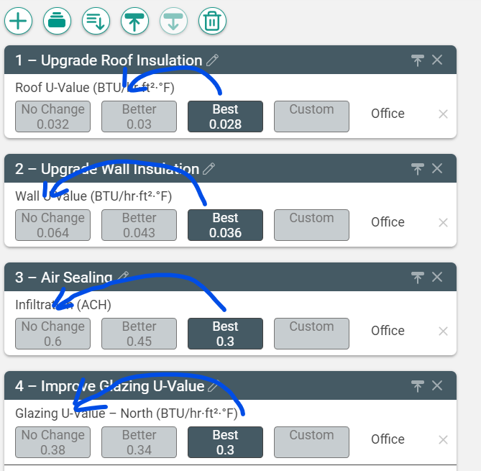
Measures values have multiple options

Slide 17
List of measures (16)
1 Upgrade roof insulation 10 Exterior lighting controls
2 upgrade wall insulation 11 Miscellaneous equipment power
3 air sealing 12 Upgrade cooling equipment
4 improve glazing u-value 13 Upgrade heating equipment
5 improve glazing SHGC 14 Demand control ventilation
6 efficient interior lighting 15 Lowflow plumbing fixtures
7 Interior lighting task tuning 16 Upgrade DHW heater
8 Interior lighting occupancy controls
9 Efficient exterior lighting
Notes:
Chat: https://forms.office.com/r/XWvFWevVF0

Slide 18
Measures examples (4)
1 Upgrade roof insulation 10 Exterior lighting controls
2 Upgrade wall insulation 11 Miscellaneous equipment power
3 Air sealing 12 Upgrade cooling equipment
4 Improve glazing u-value 13 Upgrade heating equipment
5 Improve glazing SHGC 14 Demand control ventilation
6 Efficient interior lighting 15 Lowflow plumbing fixtures
7 Interior lighting task tuning 16 Upgrade DHW heater
8 Interior lighting occupancy controls
9 Efficient exterior lighting
Notes:
Chat: https://forms.office.com/r/XWvFWevVF0

Slide 19


https://slipstreaminc.org/sketchbox
Notes:
https://slipstreaminc.org/sketchbox

Slide 20
Lesson two sample results- energy codes
Building Model | Electricity (kWh) | Natural Gas Therms | Total Cost Dollars ($)
Baseline (IECC 2018) | 1,023,333 | 36,149 | 117,152
IECC 2015 | 1,102,508 | 35,481 | 123,815
ASHRAE 2016 | 1,057,115 | 35,068 | 119,443

Slide 21
Lesson two sample results- measures
Building Model | Electricity (kWh) | Natural Gas Therms | Total Cost Dollars ($)
Baseline (IECC 2018) | 1,023,333 | 36,149 | 117,152
Update four selected measures | 940,829 | 35,877 | 109,538
“Best” Measures set | 680,520 | 11,698 | 69,353

Slide 22
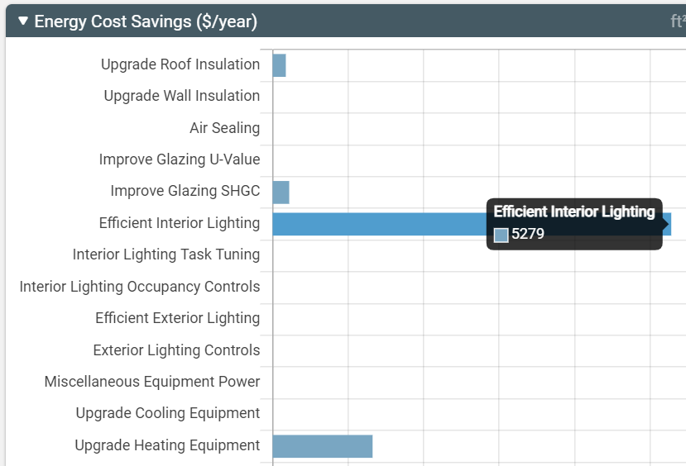
Sample results

Slide 23
Optional Extensions
Try much earlier energy code or newest
Work out carbon emissions calculations by energy code
Re-order four selected measures
Analyze which measures apply to local school building
Switch to results other than cost (e.g. natural gas)
Study the data from the “Best” full measures case, which upgrades provide the most cost savings?

Slide 24
Discussion Questions
Building Model | Electricity (kWh) | Natural Gas Therms | Total Cost Dollars ($)
Baseline (IECC 2018) | 1,023,333 | 36,149 | 117,152
IECC 2015 | 1,102,508 | 35,481 | 123,815
1. How much energy cost does the 2018 IECC code save each year compared to the 2015 IECC code? What is the highest additional building cost that would make this a good investment?

Slide 25
Discussion Questions
Building Model | Electricity (kWh) | Natural Gas Therms | Total Cost Dollars ($)
Baseline (IECC 2018) | 1,023,333 | 36,149 | 117,152
“Best” Measures set | 680,520 | 11,698 | 69,353
2. Results from “best” values for a measures set show significant improvements above IECC energy code. Should the energy code require more efficiency? Why or why not?

Slide 26
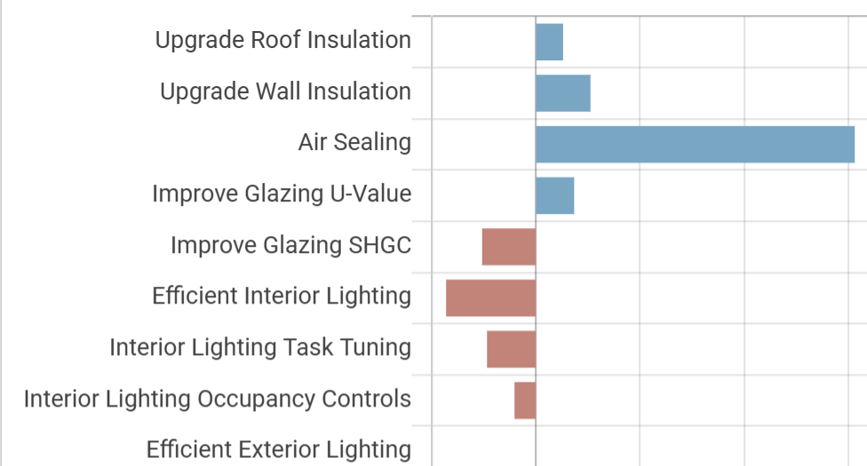
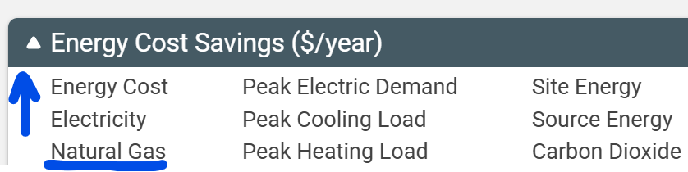
Discussion
Questions
3. Some measures increase use of natural gas when improved to a “best” value (see above), others cause no change. Why does this happen?

Slide 27
Related Slipstream Sketchbox™ tutorials
Tutorials for Specific tabs
Sketchbox: Measures
Or search on the Sketchbox™ youtube channel
Notes:
Chat: https://forms.office.com/r/XWvFWevVF0

Slide 28
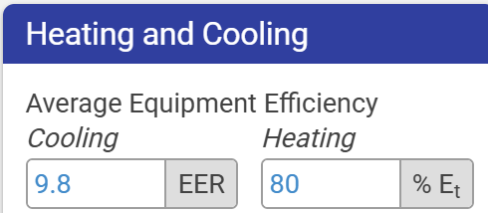
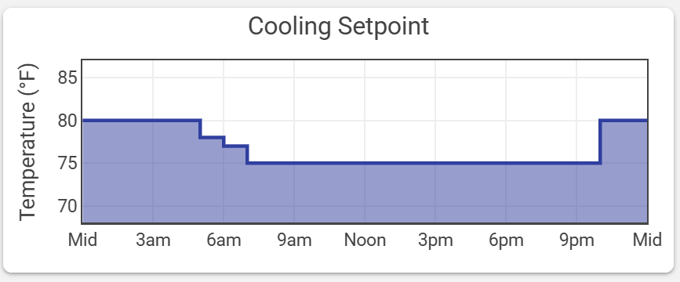
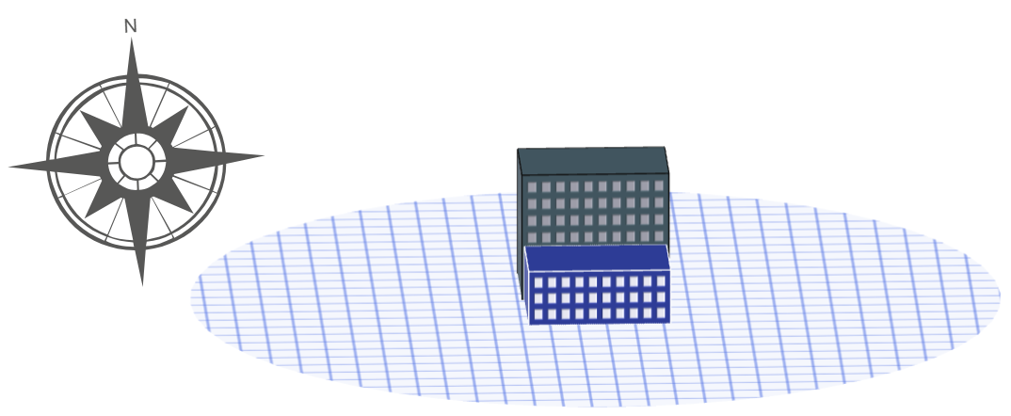
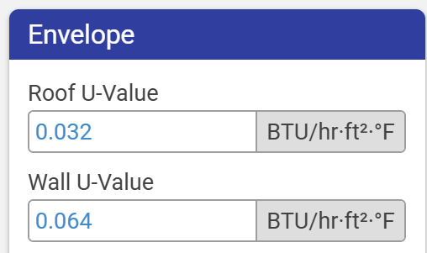
Sketchbox™Lesson 2
End of Presentation- thank you for watching!
Notes:
Chat: https://forms.office.com/r/XWvFWevVF0

