Slide 1

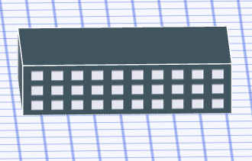
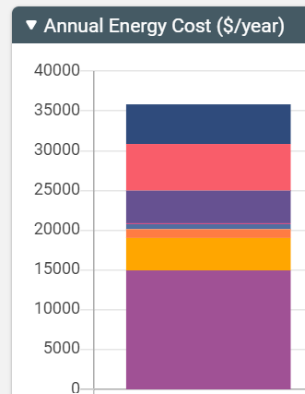
Sketchbox™ by Slipstream
Lesson 1
Introduction to building models

Slide 2


Slide 3
Energy use in buildings
Buildings use energy for heating, cooling, ventilation, hot water, lighting, computers and other equipment, and other uses
US Energy Information Administration reported buildings used 39% of energy in U.S. in 2021

Slide 4
Building modeling informs strategies to save energy
Energy and cost saving examples:
- Upgrade lighting
- Change scheduling and set points
- Update mechanical systems
- Improve building envelope

Slide 5
In this lesson you will focus on:
Building size
Window Fraction
Location (City and State)

Slide 6
Lesson Objectives:
Students can describe the scale of the amount of energy used in buildings and some ways in which this energy is used
Students can use the Sketchbox™ interface to model the energy use of a building with specific characteristics and report their results
Students can list several factors that affect building energy use

Slide 7
Important terms:
Glazing – materials, such as glass, used in windows and doors; also refers to the framing and construction of these openings
Fenestration – design and placement of windows, doors, and other openings in buildings; “fixed” fenestration refers to windows that cannot be opened, “operable” fenestration refers to windows that can be opened
Window-to-wall ratio – the percentage of a wall that is window area
Peak demand – the highest rate of energy use at any time during the year

Slide 8
Important measurement units:
kWh – kilowatt hour, a unit of energy often used for electricity; equal to the energy used at a rate of one kilowatt for one hour
Therm – an energy unit often used to measure natural gas; one therm is equivalent to 100,000 British Thermal Units (BTU’s)
kW – kilowatt, a unit of power often used to describe how fast electrical energy is being used; one kilowatt is equal to one thousand watts
BTU – British thermal unit, energy unit often used in heating and cooling
kBTU – unit of energy equal to one thousand BTU’s

Slide 9


Using Sketchbox depends on six tool tabs
Pre-loaded sample data allows quick modeling:
Building types, building size, mechanical systems, weather data and utility rates by location

Slide 10
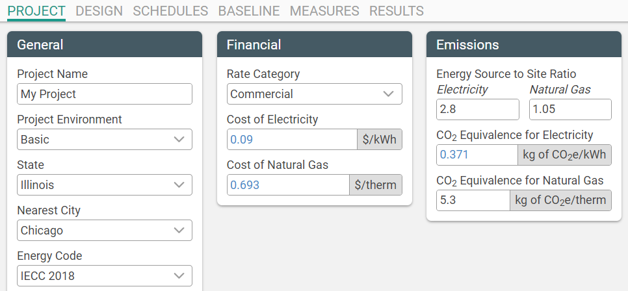
Default Project Settings in the project tab
Notes:
In Wisconsin, Focus on Energy uses the following averages for school buildings
Cost of electricity: $0.1148/kWh
Cost of Natural Gas: $0.996/therm

Slide 11
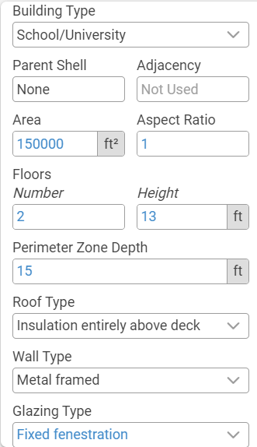
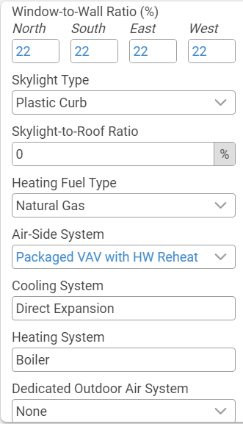
Design Tab Options

Slide 12
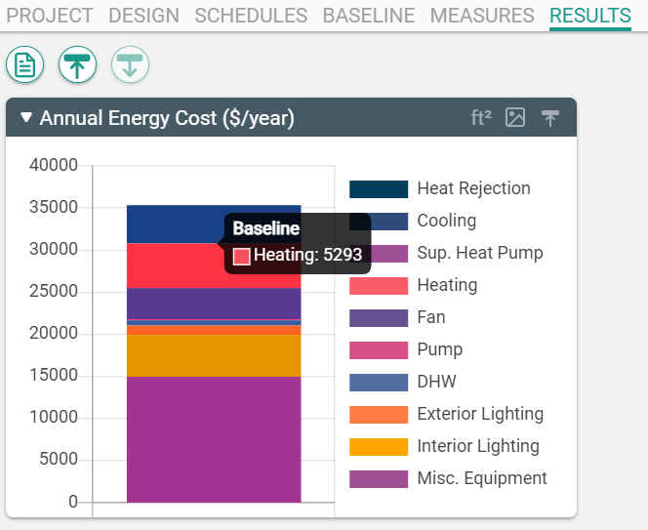
Sample displays from the results tab

Slide 13
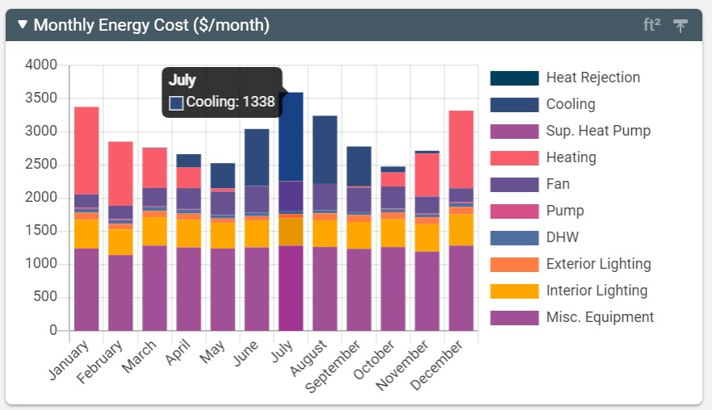
Monthly breakdown

Slide 14
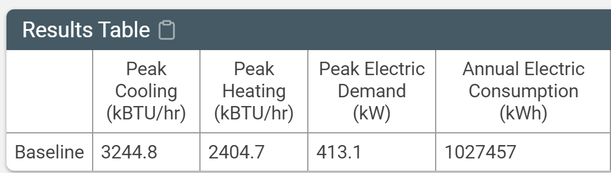
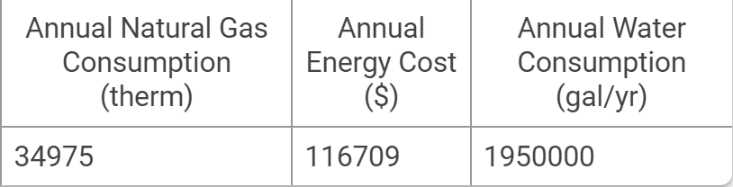
Annual Summary

Slide 15

Introductory Model
150,000 square foot school building in Chicago
Start with the project tab

Slide 16
Sketchbox Example - What if… ?
Building size reduced by half
Original building had more windows
Original building moved to Los Angeles, CA
But only make one change at a time!
Notes:
Chat: https://forms.office.com/r/XWvFWevVF0

Slide 17
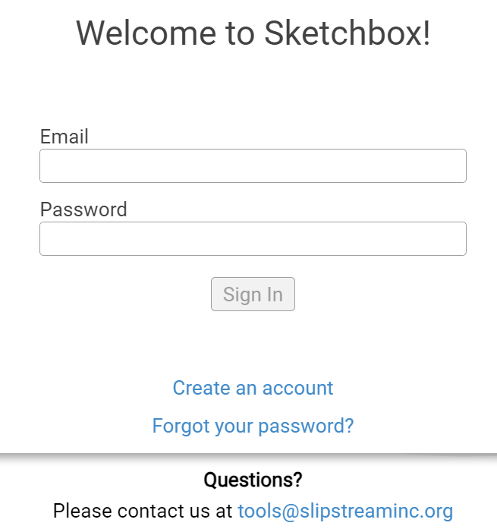

https://slipstreaminc.org/sketchbox
Notes:
https://slipstreaminc.org/sketchbox

Slide 18
Demonstration in Sketchbox
Notes:
Chat: https://forms.office.com/r/XWvFWevVF0

Slide 19
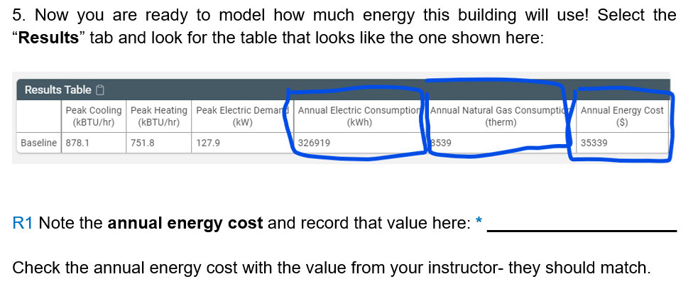
Student Data Check
Notes:
Chat: https://forms.office.com/r/XWvFWevVF0

Slide 20
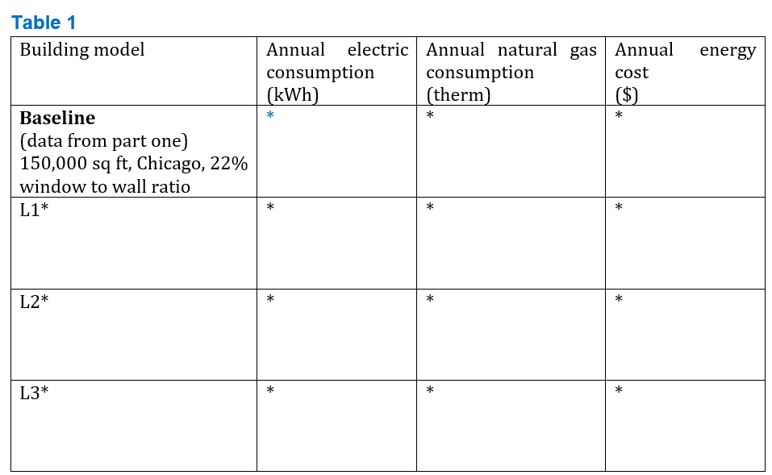
Student Data Table
Notes:
Chat: https://forms.office.com/r/XWvFWevVF0

Slide 21
Lesson 1 - Introduction to Sketchbox: Sample RESULTS
Values will change over time as updates are made
Scenario | Electricity (kWh) | Natural Gas Therms | Total Cost Dollars ($)
Baseline | 1,023,333 | 36,149 | 117,152
Half area (75,000 ft²) | 510,622 | 18,792 | 58,978
Double window area | 1,058,548 | 36,736 | 120,727
Move to LA | 1,038,341 | 9,853 | 164,809

Slide 22
Lesson 1 - Introduction to Sketchbox - RESULTS
Discussion
1. The smaller building uses less energy- explain why.
2. Does a building only half the size use only half the energy?
Scenario | Electricity (kWh) | Natural Gas Therms | Total Cost Dollars ($)
Baseline | 1,023,333 | 36,149 | 117,152
Half area (75,000 ft²) | 510,622 | 18,792 | 58,978

Slide 23
Lesson 1 - Introduction to Sketchbox - RESULTS
Discussion
3. Does doubling window area increase or decrease electricity use? Why?
4. Does doubling window area increase or decrease natural gas use? Why?
Scenario | Electricity (MWh) | Natural Gas Therms | Total Cost Dollars ($)
Baseline | 1,023,333 | 36,149 | 117,152
Double window area | 1,058,548 | 36,736 | 120,727

Slide 24
Lesson 1 - Introduction to Sketchbox - RESULTS
Discussion:
5. Why does moving to LA increase electricity use and energy cost?
6. Why is some natural gas still needed in LA even though the climate is much warmer?
Scenario | Electricity (kWh) | Natural Gas Therms | Total Cost Dollars ($)
Baseline | 1,023,333 | 36,149 | 117,152
Move to LA | 1,038,341 | 9,853 | 164,809

Slide 25
Lesson 1 - Introduction to Sketchbox - RESULTS
In Chicago electricity has a carbon impact of 0.371 kgCO₂e/kWh
In California this value is 0.191 kgCO₂e/kWh
Natural gas is 5.3 kgCO₂e/therm for all locations
Scenario | Electricity (kWh) | Natural Gas Therms | Total Cost Dollars ($)
Baseline in Chicago | 1,023,333 | 36,149 | 117,152
Move to Los Angeles | 1,038,341 | 9,853 | 164,809

Slide 26
Lesson 1 - Introduction to Sketchbox - RESULTS
Energy cost is higher in Los Angeles and emissions are lower
Emissions
Chicago: Los Angeles:
571,246 kg-CO2e 250,544 kg-CO2e
Scenario | Electricity (kWh) | Natural Gas Therms | Total Cost Dollars ($)
Baseline in Chicago | 1,023,333 | 36,149 | 117,152
Move to Los Angeles | 1,038,341 | 9,853 | 164,809

Slide 27
Optional Extensions
Students can select an additional city of their choice for comparison to Chicago and Los Angeles
Reduce window percentage on north wall but increase window percentage on south wall
Change another parameter of interest (additional lessons study energy codes, schedules, measures sets, set points, carbon emissions, and building shape)
Notes:
Chat: https://forms.office.com/r/XWvFWevVF0

Slide 28
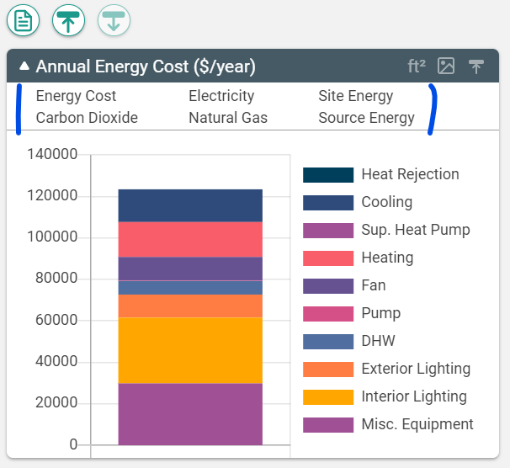
Other display options

Slide 29
Related Slipstream Sketchbox™ tutorials
Welcome to Sketchbox: Your Trusted Energy Modeling Tool
Tutorials for Specific tabs
Sketchbox: Project
Sketchbox: Design
Sketchbox: Results
Notes:
Chat: https://forms.office.com/r/XWvFWevVF0

Slide 30
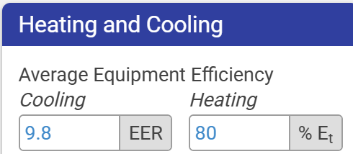
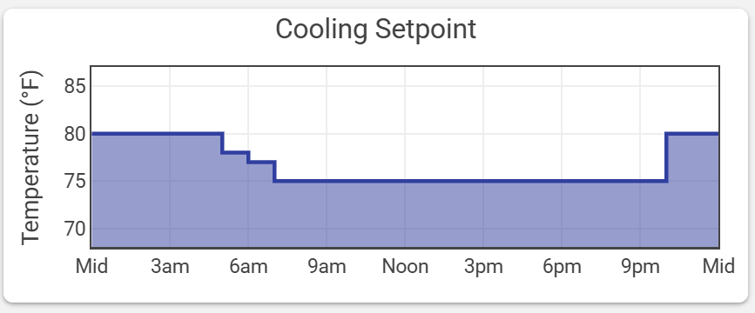
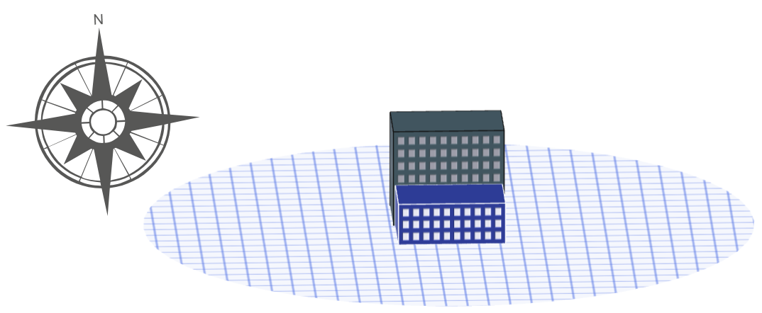
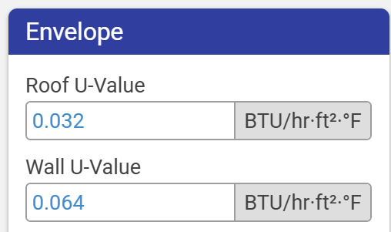
Sketchbox™Lesson 1
End of Presentation- thank you for watching!
Notes:
Chat: https://forms.office.com/r/XWvFWevVF0

